Slide 1


IMPLEMENTING VIRTUAL ASSISTANT USING CNN FOR TRAVEL PLANNER
UNDER THE GUIDANCE OF
Dr. D Santhosh Kumar
Assistant Professor, ECE
VNRVJIET
PRESENTED BY: Batch-15, ECE-4
G VAMSHIDHAR - 17071A04K5
N RAJESH - 17071A04M5
RAM PENTAPATI - 17071A04N1
P PAVAN KUMAR - 18075A05445

Slide 2


Introduction
This Pandemic had made everything online/digital to avoid Physical distance/ Human Contact.
Digital Process is new to many people, They have of lot of queries related to working of applications, Organizations hire people for customer support but increasing no of customers, customer support/executive are unable to handle hundreds of people at a time.
So most of the people’s queries remained unsolved.
Here comes Virtual Assistant into picture.

Slide 3
OVERVIEW OF THE PROJECT
Virtual Assistant implentation using Convolutional Neural Network (CNN) for Travel Planner.
Collecting Data from different Resources.
Implementing Virtual Assistant for Travel Planner:
Showing Categories of places (Hill Stations, Waterfalls).
Selecting State for vacation.
Displaying basic journey details (Travel duration, Mode of Transport, Cost).
Opting for mode of transport based on their interest.
Integrating this model with web-application.

Slide 4

Problem statement
Organisations are spending huge amount on customer support, Customer Service and still unable to resolve all the queries of Users efficiently.
Virtual Assistant would reduce the amount spent, work pressure on Customer Support and also enhances User experience

Slide 5

Motivation
ACrazyTourist, Start-up (Yet to be recognized by Government of India).
It is start-up they plan for trips based on customer interest, As they are start-up hiring customer support is not possible. Our Virtual Assistant would be useful in guiding the customers to select their trip based on their interest/requirement.

Slide 6


Aim of the project
THE AIM OF THIS PROJECT IS TO
To build Virtual Assistant that answers the queries of the users.
Implementing Virtual Assistant for Travel Planner
Integrating model with that web-application.

Slide 7
objectives OF THE PROJECT
To enable user input in both text and speech/voice.
To Display output based on user requirement (text or Speech/voice).
To Answer maximum number of possible queries.
Building Virtual Assistant for Travel Planner.
To Integrate Model with web-application.

Slide 8


OBJECTIVE 1: To enable user input
Our Virtual Assistant will be accepting the input as text or speech, To accept speech as input we will be using system microphone, Speech recognition (Python Library).
Later using Speech-to-Text conversion technique (Provided by Speech recognition library), Speech input is converted into text and processed.

Slide 9


OBJECTIVE 2: TO DISPLAY output (text or speech)
Output will be displayed based on user requirement, By default text will be displayed if user wants it in speech we use speech-to-text conversion technique (Provided by Speech Recognition Library) and text is converted into speech and displayed to user.

Slide 10



Objective 3: To integrate model with web-application
We will be building web-application using HTML,CSS, Bootstrap, Later we will be using Docker to integrate our model with web-application.

Slide 11
Literature survey
S.NO | NAME OF THE JOURNAL | YEAR | NAME OF THE AUTHORS | WORK CONTRIBUTED | MERITS AND DEMERITS OF WORK
1 | Critical Literature Review on Chatbots in Education (IJTSRD) | 2020 | Hephzibah Thomas | This paper focuses on text input and text output . And also this paper talks about usage of chat-bots in educational fields. | This paper only uses text to text . Using speech to speech and text to text or text to speech would be much better.
2 | Implementation of Virtual Assistant with Sign Language using Deep Learning and Tensor Flow | 2021 | Vani Valsaraj | This project converts sign language to text using deep learning and tensor flow. | This is explicitly useful for deaf and dumb. If output is in text, output in speech would be better.
3 | Jarvis - A Virtual Assistant based on Artificial Intelligence | 2020 | Dr.M. Sharada Varalakshmi, Dr.P. Lavanya | This paper talks about speech recognition approach. | This paper explained about approach of Speech recognition but not any implementation.
4 | A Review Paper on Smart Personal Assistant | 2016 | Yogendra Kumar Sharma Neeraj Sharma | This Paper talks about overview of applications of Smart Personal Assistant in various fields. | They didn't talk about any architecture Just gave a brief on Smart Personal Assistant.

Slide 12
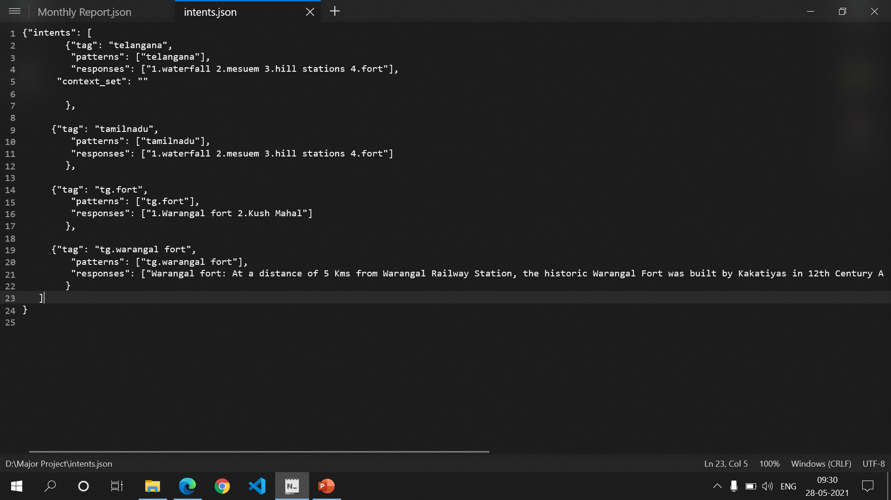
DATA SET

Slide 13
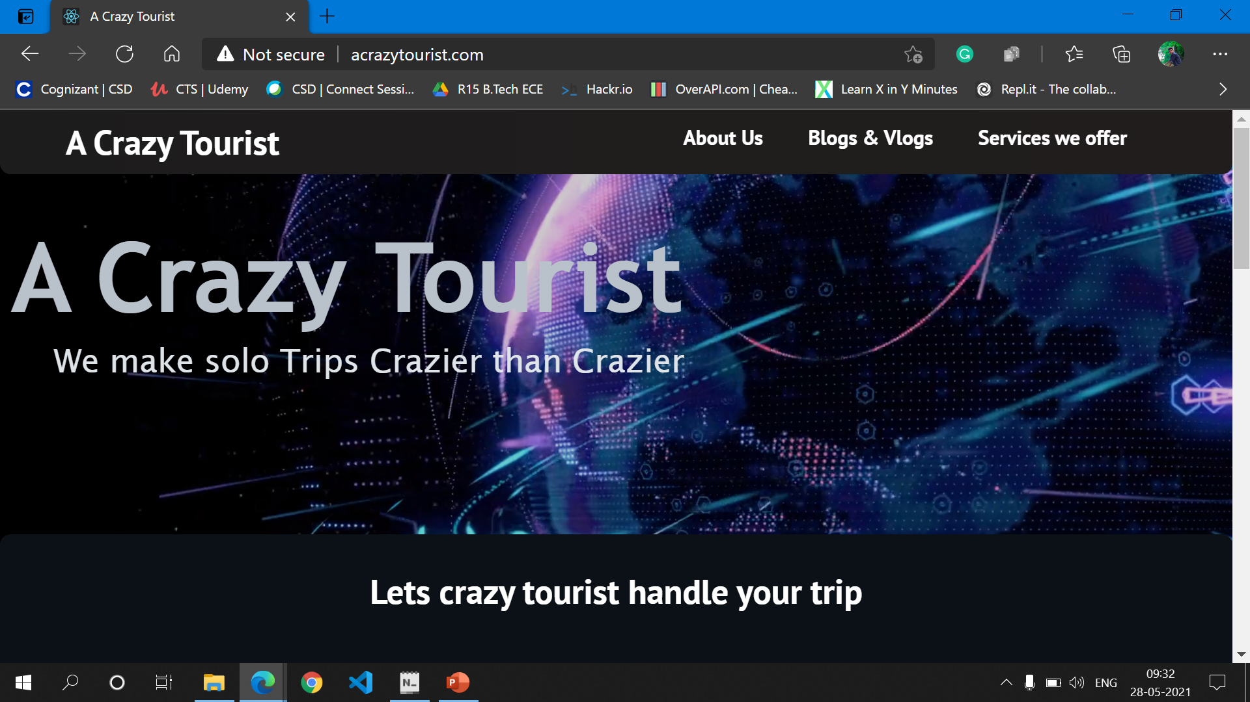
WEBSITE TEMPLATE

Slide 14
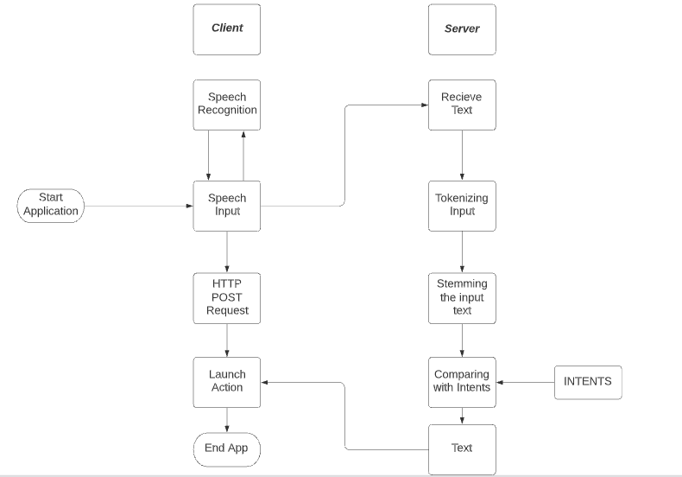
Flow CHART of the project

Slide 15
PROJECT STEPS
PROJECT STEPS | PROJECT OBJECTIVE DESCRIPTION
STEP 1 | Understanding Virtual Assistant working.
STEP 2 | Understanding Speech recognition, Text to Speech, Speech to Text Conversion.
STEP 3 | Data Collection and Manipulation.
STEP 4 | Writing Code for Entire Project. Training and Testing the model..
STEP 5 | Integrating with Web-Application
STATUS
DONE
DONE
IN PROGRESS
IN PROGRESS
Yet to start

Slide 16
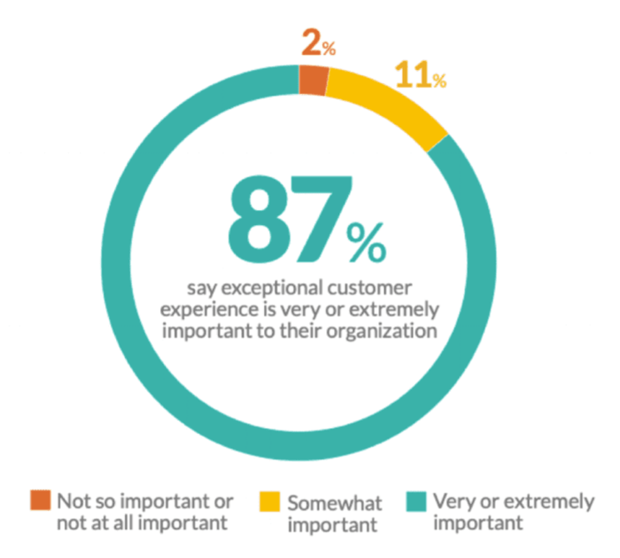
importance of proposed project in the context of current status
According to report on Smart Insights by Expert commentator states that 87% of customer base are concerned with customer service, Best Customer support will provide great experience
Hence, our proposed project will be of great use.

Slide 17
Expected outcome of the project
Virtual Assistant for Travel Planner.
User input: Text or Speech.
Output: Text or Speech.

Slide 18
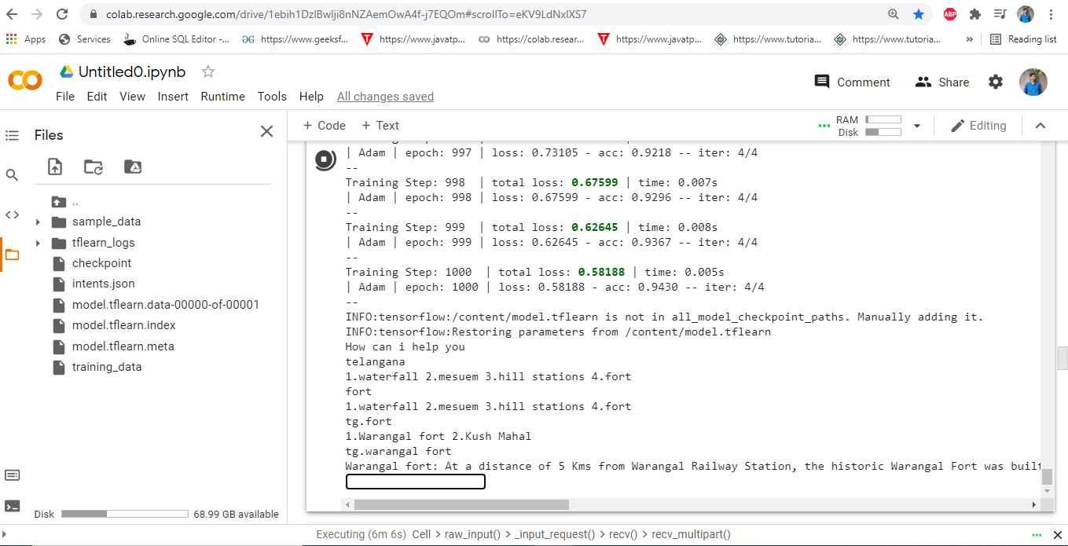

Slide 19




applications

Slide 20
TIME SCHEDULE OF ACTIVITIES
S.NO | TASK | TENTATIVE DATES & DURATION | NO. OF DAYS REQUIRED
1 | Problem statement and picturizing the project | 17-03-2021 to 21-03-2021 | 5
2 | STEP 1 | 26-03-2021 to 02-04-2021 | 7
3 | STEP 2 | 02-04-2021 to till date | -
4 | STEP 3 | 06-04-2021 to till date | -
5 | STEP 4 | 22-04-2021 to till date | -
6 | STEP 5 | 12-05-2021 to 15-05-2021 | 3
7 | Thesis Preparation | Before final review | 5
8 | Final Slides Preparation | Before final review | 3

Slide 21

SOFTWARE(s) USED in the project
Python
Pandas
NUMPY
Speech Recognition
Natural Language Processing (NLP)
Convolutional Neural Network (CNN)
Tools Used:
Google Collab.
VS CODE
Python IDE

Slide 22
ROLES AND RESPONSIBILITIES
S.NO | NAME OF THE STUDENT | ROLES AND RESPONSIBILTIES
1 | G VAMSHIDHAR(4K5) | Implementation, Training and Testing.
2 | N RAJESH(4M5) | Data Collection and Manipulation
3 | RAM PENTAPATI(4N1) | Implementation, Training, Testing, Research, Documentation
4 | P PAVAN KUMAR(445) | Research, Data Collection and Manipulation.

Slide 23
references
[1] Dr.M. Sharada Varalakshmi, Jarvis - A Virtual Assistant based on Artificial Intelligence, International Journal of Grid and Distributed Computing Vol. 13, No. 2, (2020), pp. 776 – 784
[2] Yogendra Kumar Shar m a , A Review Paper on Smart Personal Assistant, International Journal of Engineering Research & Technology (IJERT) ISSN: 2278-0181 Published by, www.ijert.org V-IMPACT - 2016_2 Conference Proceedings
[3] Hephzibah Thomas , Critical Literature Review on Chatbots in Education , International Journal of Trend in Scientific Research and Development (IJTSRD) Volume 4 Issue 6, September-October 2020 Available Online: www.ijtsrd.com e-ISSN: 2456 – 6470
[4] Vani Valsaraj, Implementation of Virtual Assistant with Sign Language using Deep Learning and TensorFlow, International Journal for Research in Applied Science & Engineering Technology (IJRASET) ISSN: 2321-9653; IC Value: 45.98; SJ Impact Factor: 7.429 Volume 9 Issue I Jan 2021- Available at www.ijraset.com

Slide 24
references
[5] The Alexafication of Adult Social Care: Virtual Assistants and the Changing Role of Local Government in England, International Journal of Environmental Research and Public Health
[6] Nanaware, Rasika. “Chatbot for Education System.”, Corpus ID: 58318311, (2018).
[7] Clarizia F., Colace F., Lombardi M., Pascale F., Santaniello D. (2018) Chatbot: An Education Support System for Student
[8] Lai, H. and Lai, H., 2014. Real-Time Dynamic Hand Gesture Recognition. International Symposium on Computer, Consumer and Control, pp.658-66

Slide 25
Thank you
BATCH-15

